Slide 1
Organic carbon stabilization controlled by geochemistry in tropical rainforest soils
vEGU21
Session SSS5.1 „Mechanisms of soil organic matter stabilization and carbon sequestration“
vPICO presentation on Thursday, 29. April 2021, 14:20-14:25 CEST
Breakout text chat at 14:40-15:00 CEST
Mario Reichenbach
Water and Soil Resource Research
Tropical Soil Organic Carbon Dynamics
Contact: mario.reichenbach@geo.uni-augsburg.de
Follow us: https://www.congo-biogeochem.com/tropsoc
More infos: https://doi.org/10.5194/soil-2020-92

Slide 2
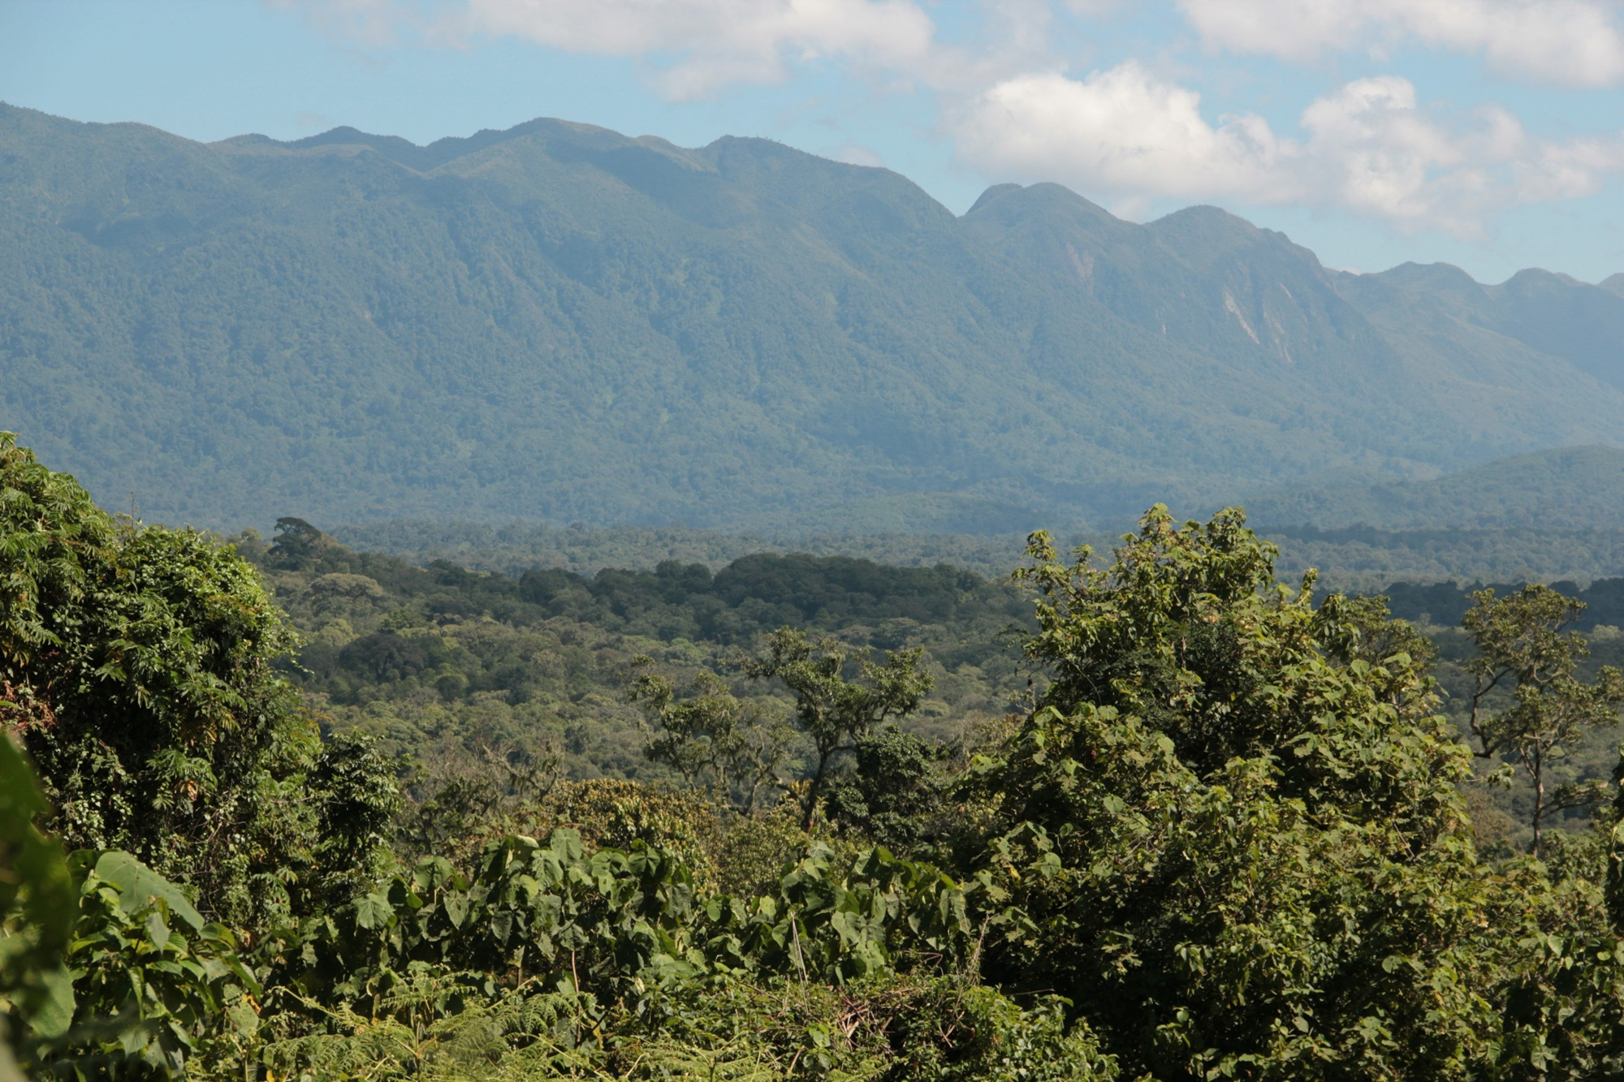
Organic carbon stabilization controlled by geochemistry in tropical rainforest soils
Does parent material geochemistry impact soil properties that affect carbon (C) stabilization and hence govern patterns of soil organic carbon (SOC) stocks?
Mario Reichenbach¹, Peter Fiener¹, Gina Garland², Marco Griepentrog², Johan Six², and Sebastian Doetterl^{1,2}
¹Institute of Geogrpaphy, Augsburg University, Augsburg, 86159, Germany
²Department of Environmental System Science, ETH Zurich, Zurich, 8092, Switzerland

Slide 3
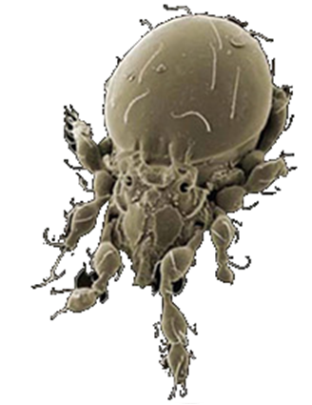
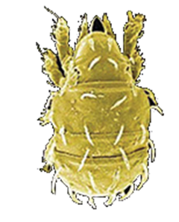
Relevance Study Aim Study Area Study Design Lab analysis Results & Discussion Conclusion
What protects SOC from microbial decomposition?
Environmental conditions
In a nutshell SOC is stabilized by four interacting mechanisms:
Chemical recalcitrents due to complex molecular structures
Organo-mineral complexes by interaction SOC with reactive mineral surfaces
Incapsulation within soil aggregates
And lastly, by the reduction of decomposition rates by soil environmental conditions
Aggregation
Organo-mineral associations
Chemical structure
SOC
(Global Soil Biodiversity Atlas and Joint Research Centre)
But is this also valid for tropical soils?

Slide 4
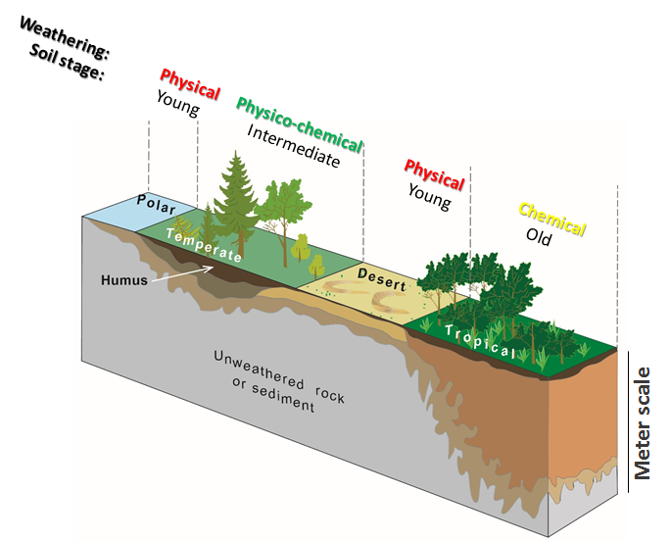
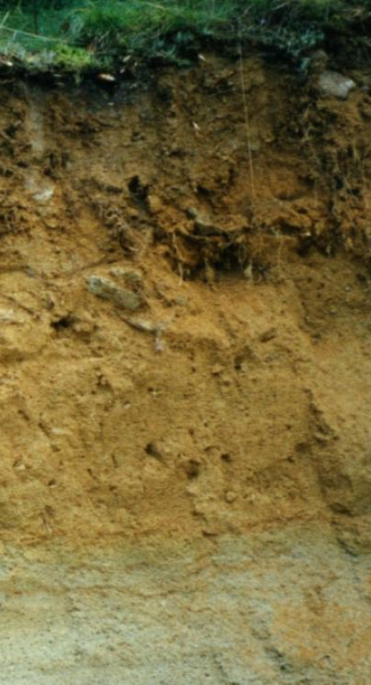
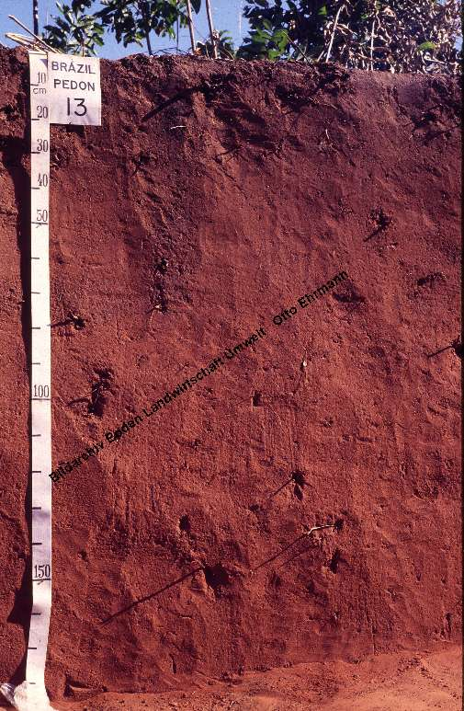
Relevance Study Aim Study Area Study Design Lab analysis Results & Discussion Conclusion
Why not transferring the findings from
the temperate zones to the tropics?
Soils are a function of climate, parent
material, vegetation and land use
Different soil formation and ability to sequester C in tropical soils compared to temperate climate zones!
(unpublished)

Slide 5
Relevance Study Aim Study Area Study Design Lab analysis Results & Discussion Conclusion
Research question: Does parent material geochemistry in tropcial pristine rainforest systems impact soil properties that affect C stabilization and hence govern patterns of SOC stocks?
H1: Despite deep and long lasting tropical weathering, we expect differences in soil chemistry that relate back to parent material chemistry. This will in turn result in contrasting geochemical soil properties that affect the formation of C stabilization mechanisms (organo-mineral associations and soil aggregates), and hence govern patterns of SOC stocks and stability. More SOC will be stabilized against microbial decay in geochemical regions, where soils are prone to the development of higher content of clay and pedogenic oxides relevant for the stabilization of C with minerals.
H2: SOC stocks in soils developed from deeply weathered FOC bearing parent material will show high contents of FOC in subsoils, but decreasing content in topsoils, as the decomposition of FOC is facilitated through priming at the soil surface in the presence of more readily available nutrient sources and higher microbial activity.
Aims: Determine the effect of geochemical soil properties developed from different parent material in the tropics on
SOC stocks
SOC fractions
SOC stabilization mechanisms
and to assess the contribution of fossil organic carbon (FOC) to SOC stocks in mixed sedimentary rocks derived soils.

Slide 6
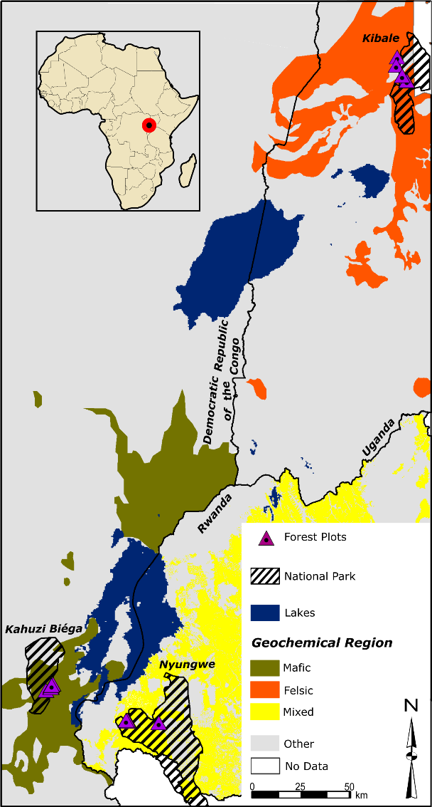
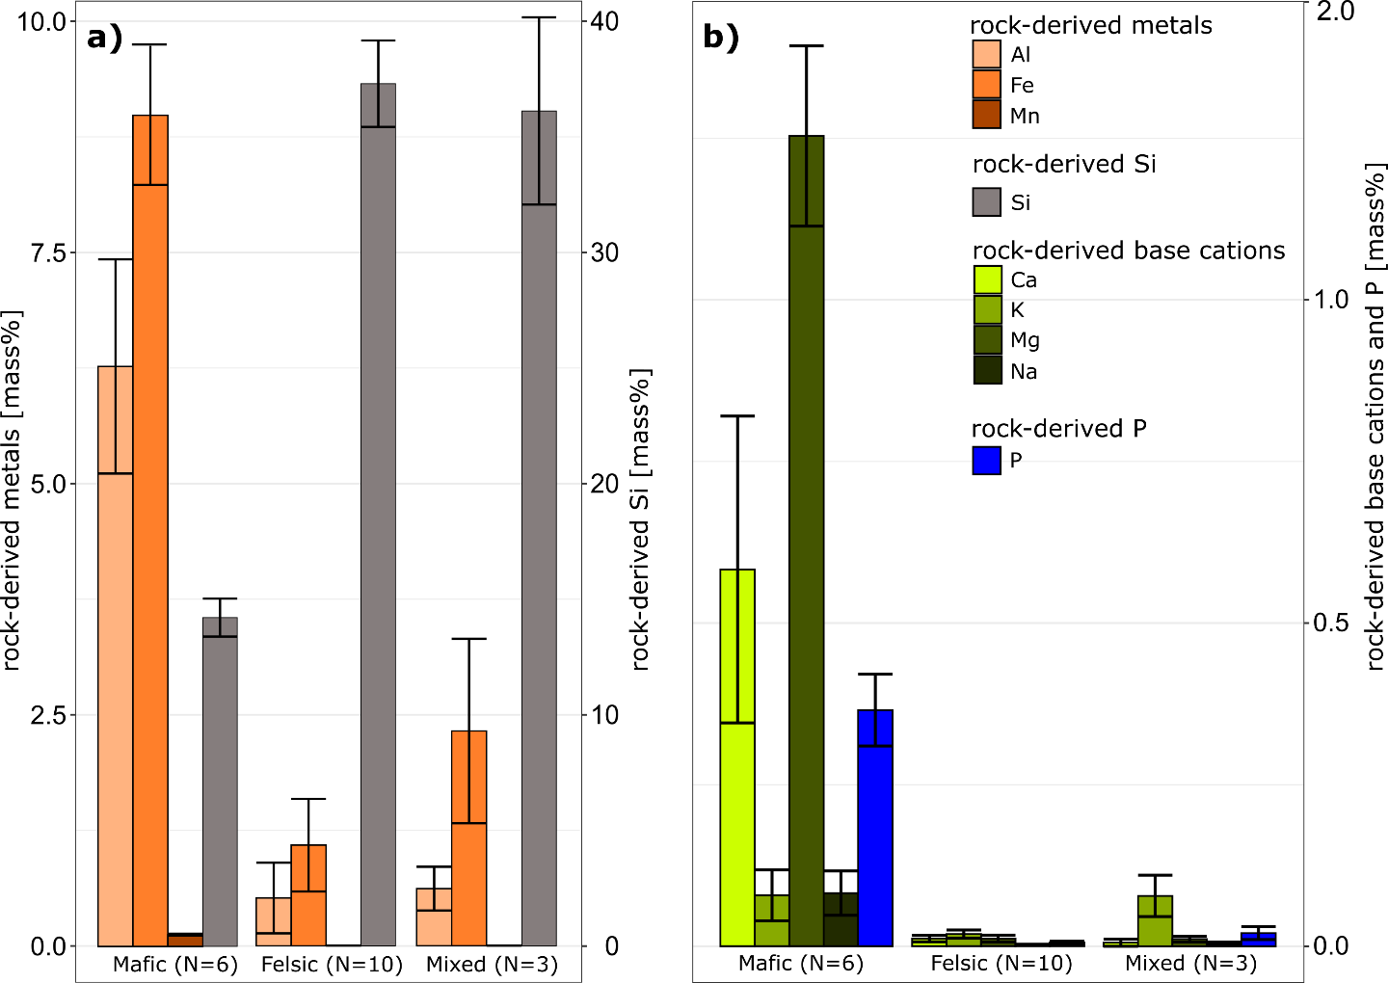
Relevance Study Aim Study Area Study Design Lab analysis Results & Discussion Conclusion
Study regions are located within primary tropical mountain forests in the eastern part of the Congo basin...
Chemical composition of unweathered rock samples representing the parent material for soil formation (Doetterl et al., 2021). Note the difference in scale on y axis between panel a) and b). Bar reprsent mean and error bar shows the standard error.
...providing parent material ranging from mafic to felsic magmatic rocks as well as sedimentary rocks of mixed geochemical composition containing C-rich slates.
Overview of study area with respect to soil parent material geochemistry (modified after Doetterl et al., 2021)

Slide 7
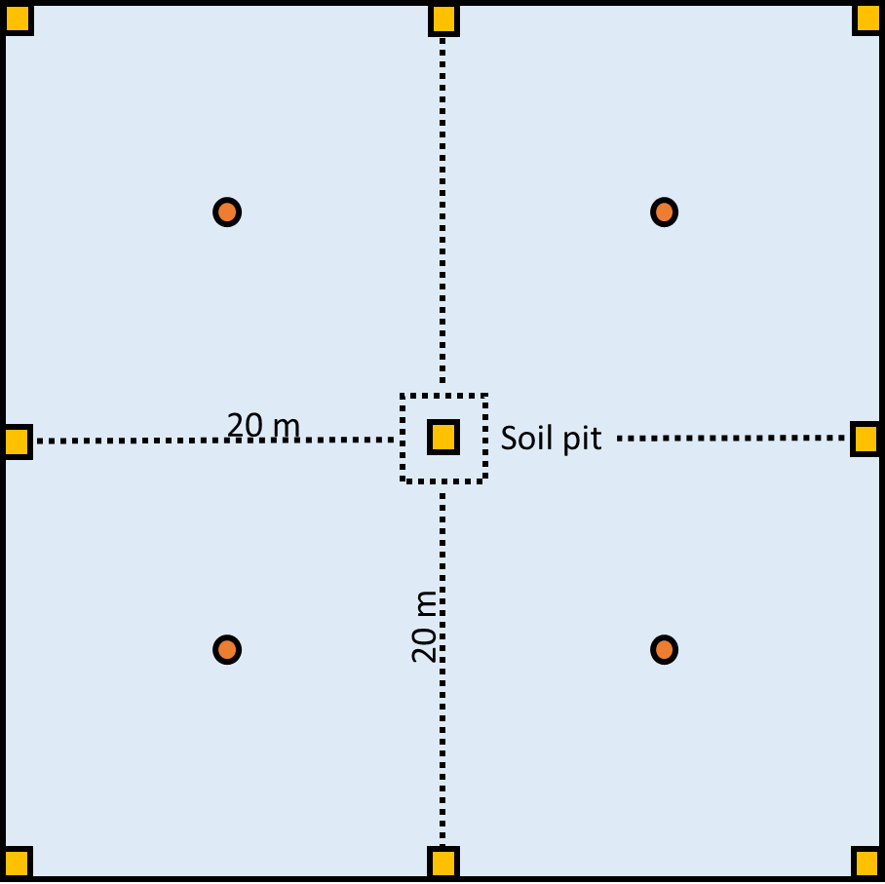
Relevance Study Aim Study Area Study Design Lab analysis Results & Discussion Conclusion
40 m
Catena approach in three geochemical regions with three field replicates per position
Soil profile
Plot 40 x 40 m
plateau
upper slope
40 m
mid slope
valley
Soil sampling design:
Soil core up to 1 m depth in each subplot
Combining 4 soil cores to one composite sample with 10 cm depth increments
Soil profile composite samples with 10 cm depth increments
Litter (L) and organic layer (O) samples from each Subplot combined to one composite sample
Soil coring
L & O horizon sampling

Slide 8
Relevance Study Aim Study Area Study Design Lab analysis Results & Discussion Conclusion
Analyzing soil C fractions representing different stabilization mechanisms and turnover
Analyzing reactive mineral fractions relevant for C stabilization
Additional analysis:
Total element analysis (Ca, Mg, Na, K, P, Al, Fe, Mn, Ti, Si, Zr)
Basic soil properties (texture, pH, eECEC, base saturation, plant available P)
Δ¹⁴C (for comparing relative C ages)
(Reichenbach et. al. 2021 submitted)

Slide 9
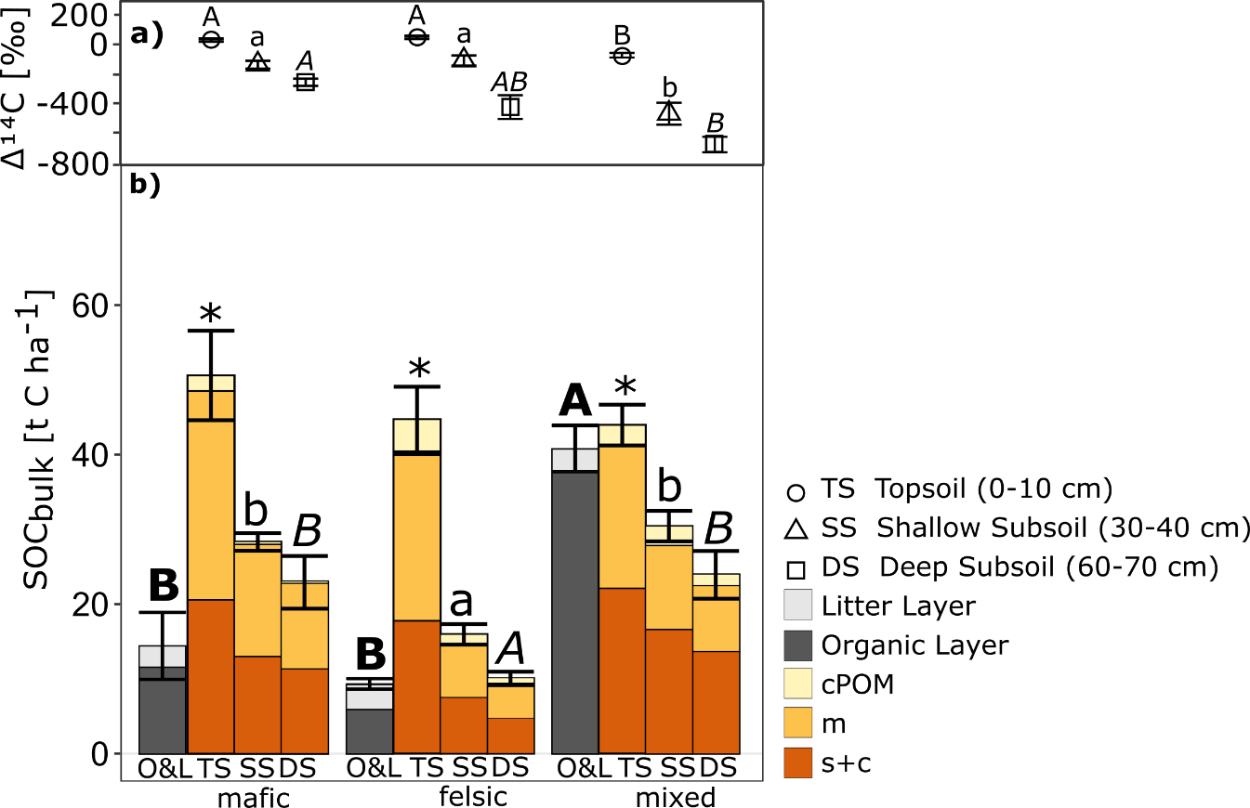
Relevance Study Aim Study Area Study Design Lab analysis Results & Discussion Conclusion
Differences in the soil C fractions and the abundance of reactive secondary minerals differed significantly across geochemical regions, indicating that mafic soils can protect C better than their felsic or mixed sediment counterparts.
Major findings
Higher soil organic carbon (SOC) stocks in soils derived from mafic compared to felsic derived soils due to higher amount of reactive secondary minerals.
Soils derived from mixed sedimentary rocks show higher SOC stocks compared to felsic derived soils which is explained by fossil organic carbon (FOC) and not by mineral-related SOC stabilization. FOC content decreases in topsoils compared to subsoils indicating microbial decay.
Without the FOC, the SOC stocks of the sediment derived soils would be comparable to the felsic derived soils due to the lack of stabilization partners.
Amount of FOC
a) Δ¹⁴C isotopes (n = 3 per bar) and b) SOC stocks and fractions (n = 9 per bar) across geochemical regions. Bar represents mean and error bar shows standard error. Astersiks indicate no significant difference in means (p > 0.05) (modified after Reichenbach et al. 2021, submitted).

Slide 10
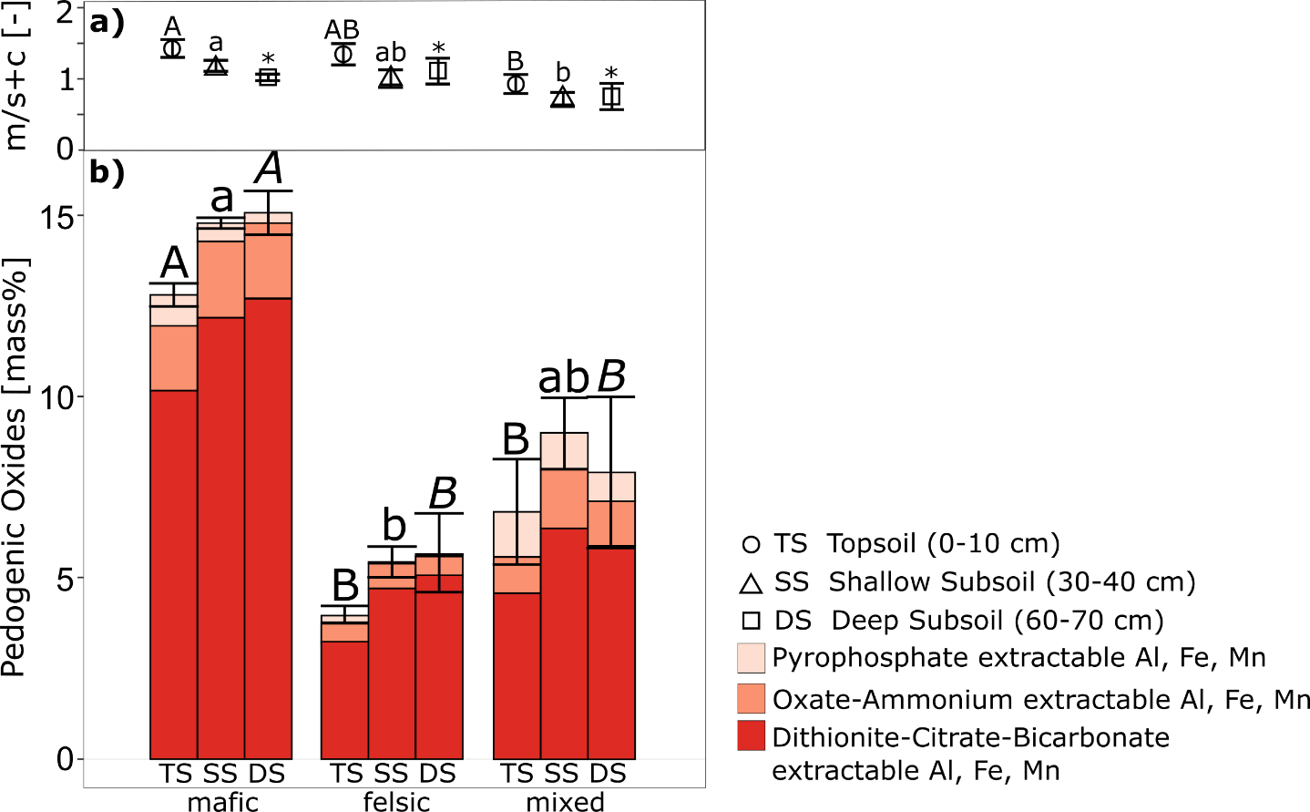
Relevance Study Aim Study Area Study Design Lab analysis Results & Discussion Conclusion
Differences in the soil C fractions and the abundance of reactive secondary minerals differed significantly across geochemical regions, indicating that mafic soils can protect C better than their felsic or mixed sediment counterparts.
Major findings
Mafic derived soil contain significant more reactive secondary minerals than felsic or sediment derived soils.
Mafic derived soils store more C in microaggregates than other soils.
a) Microaggregate associated C / free silt and clay associated C ratio (m/s+c, n = 9 per bar) and b) pedogenic oxide fractinos of the sequential extractions across geochemical regions (n = 3 per bar). Bar represents mean and error bar shows standard error. Astersiks indicate no significant difference in means (p > 0.05) (Reichenbach et al. 2021, submitted).

Slide 11
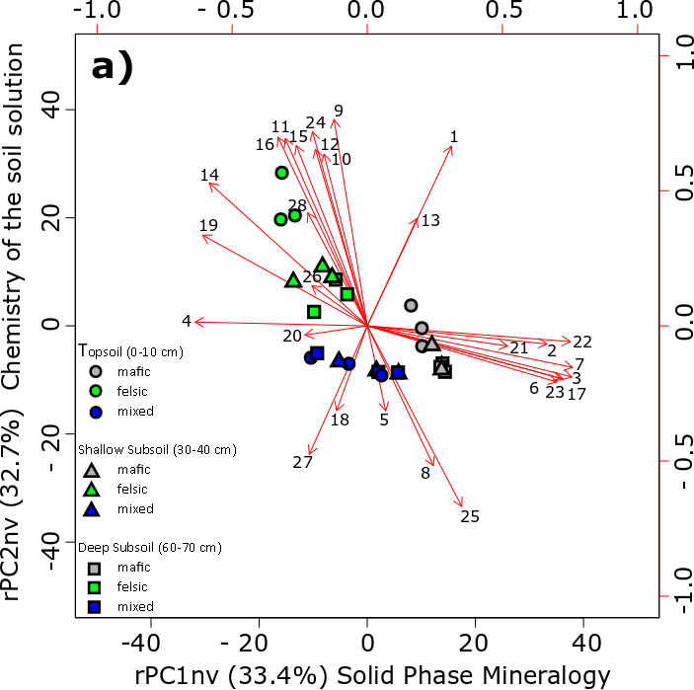
Relevance Study Aim Study Area Study Design Lab analysis Results & Discussion Conclusion
Multiple linear stepwise regression analysis (beta coefficients) and relative importance analysis in brackets for non-valley soils. SOC_{bulk}, Δ¹⁴C and m / s+c ratio are explained by soil depth and the extracted rPCs. *p <0.1; **p <0.05; ***p <0.01. Adjusted R² displays the goodness of fit and the root mean square error (RMSE) assesses the model quality (Reichenbach et al. 2021, submitted).
response | soil depth | rPC1_{nv} - solid phase mineralogy | rPC2_{nv} - chemistry of the soil solution | rPC3_{nv} - silt content | rPC4_{nv} - organo- mineral complexes | adjusted R² | RMSE
SOC_{bulk} | -0.77*** (82 %) |  |  |  | 0.31*** (18 %) | 0.73 | 0.46
Δ¹⁴C | -0.87*** (75 %) | 0.39** (4 %) |  | 0.24* (16 %) | -0.32* (5 %) | 0.75 | 0.47
m / s+c | -0.29* (23 %) | 0.74*** (31 %) | 0.8*** (46 %) |  |  | 0.44 | 0.39
Major findings
Despite prolonged chemical weathering, parent material leaves a long-lasting footprint in chemical soil properties.
Chemical soil properties together with soil depth explain up to 75 % variances of SOC stock and relative C age (Δ¹⁴C) and also 44 % in the variability in the relative abundance of C associated with microaggregates versus C associated with the free silt and clay fraction.
Biplot of varimax-rotated principal component analysis (n = 27). Plot shows rotated principal component 1 and 2 (modified after Reichenbach et al. 2021, submitted). rPC1 Solid Phase mineralogy: i. a. metals (∑ total Al, total Fe, total Mn), DCB extr. oxides (Al, Fe, Mn), Al / Si ratio. rPC2 Chemistry of the soil solution: i. a. Exchangeable bases, soil pH (KCl), base saturation. Geochemical regions are clustering together.

Slide 12
Relevance Study Aim Study Area Study Design Lab analysis Results & Discussion Conclusion
What did we learn?
H1: Geochemical soil properties will affect the formation of C stabilization mechanisms (organo-mineral associations and soil aggregates), and hence govern patterns of SOC stocks and stability.
Differences in the soil C fractions and the abundance of reactive secondary minerals differed significantly across geochemical regions, indicating that mafic soils can protect C better against microbial decay than their felsic or mixed sediment counterparts
Strong impact of geochemical variables in explaining SOC and mineral related C stabilization is a function of reactive mineral surfaces dependent on parent material geochemistry
These mechanisms are similar to less weathered soils in other climate zones, but their relative importance is markedly different in the investigated tropical soils
H2: Decomposition of FOC will take place under topsoil conditions with higher microbial activity
FOC content decreases in topsoils compared to subsoils indicating microbial decay
FOC needs to taken into account as an active C pool to fully understand SOC dynamics

